Slide 1
Hybrid Intelligent Systems
Litty Tressa George
Lecturer FICT
Litty Tressa George
Lecturer FICT
Section 3 PPT 3

Slide 2
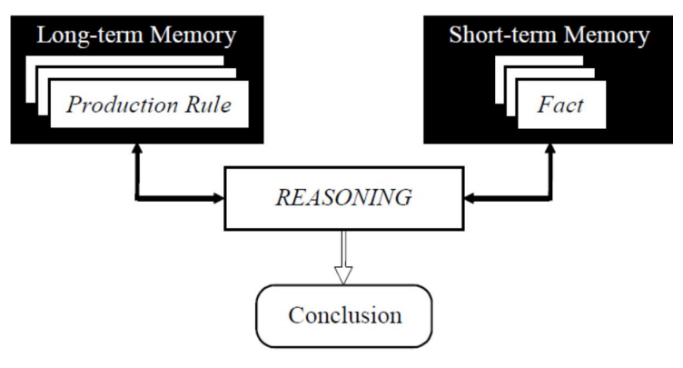
Rule-Based System
In the early seventies, Newell and Simon from Carnegie-Mellon University proposed a production system model, the foundation of the modern RBESs.
The production system model is based on the idea that humans solve problems by applying their knowledge (expressed as production rules) to a given problem represented by problem-specific information (facts).
The production rules (rules) are stored in the long-term memory and the problem-specific information (facts) in the short-term memory.
Fig: Production System Model

Slide 3
Rule-based Systems
Rule-based systems or production systems are computer systems that use rules for decision making ie to provide recommendations or diagnoses, or to determine a course of action in a particular situation or to solve a particular problem.
A rule-based system consists of a number of components:
■ a database of rules
■ a database of facts
■ an interpreter, or inference engine
In a rule-based system, the knowledge base consists of a set of rules that represent
the knowledge that the system has.
The database of facts represents inputs to the system that are used to derive conclusions, or to cause actions.
The interpreter, or inference engine, is the part of the system that controls
the process of deriving conclusions. It uses the rules and facts, and combines them together to draw conclusions.

Slide 4
RULE-BASED EXPERT SYSTEMS
1. The People Involved in an Expert System
2. Architecture of an Expert System
3. The Expert System Shell
4. The Rete Algorithm
5. Knowledge Engineering
Mandatory Reading: Chapter 2 of the textbook - Artificial Intelligence- A Guide to Intelligent Systems,Second Edition Michael Negnevitsky

Slide 5
RULE-BASED EXPERT SYSTEMS
An expert system is one designed to model the behavior of an expert in a field, such as medicine ,geology etc.
Rule-based expert systems are designed to be able to use the same rules that the expert would use to draw conclusions from a set of facts that are presented to the system.
The People Involved in an Expert System
1. End-user
The design, development, and use of expert systems involves a number of people.
The end-user of the system is the person who has the need for the System.
In the case of a medical diagnosis system, this may be a doctor, or it may be an individual who has a complaint that they wish to diagnose.

Slide 6
2.The Knowledge Engineer
The knowledge engineer is the person who designs the rules for the system, based on either observing the expert at work or by asking the expert questions about how he or she works.
3. The Domain Expert
The domain expert is very important to the design of an expert system.
In the case of a medical diagnosis system, the expert needs to be able to
explain to the knowledge engineer how he or she goes about diagnosing illnesses.

Slide 7
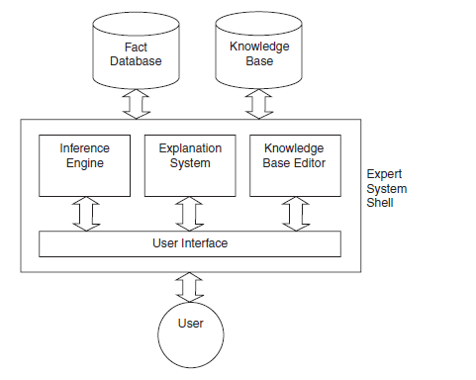
Architecture Of An Expert System

Slide 8
Knowledge Base
2. Architecture Of An Expert System
The knowledge base contains the domain knowledge useful for problem solving.
• In a RBES, the knowledge is represented as a set of rules.
• Each rule specifies a relation, recommendation, directive, strategy or heuristic and has the IF(condition) THEN (action) structure.
• When the condition part of a rule is satisfied, the rule is said to fire and the action part is executed
Database
The database includes a set of facts used to match against the IF (condition) parts of rules stored in the knowledge base.

Slide 9
Inference Engine
The inference engine carries out the reasoning whereby the ES reaches a solution.
The inference engine links the rules given in the knowledge base with the facts provided in the database.
Explanation Facilities
The explanation facilities enable the user to ask the ES - how a particular conclusion is reached, and - why a specific fact is needed.
An ES must be able to - explain its reasoning, and - justify its advice, analysis or conclusion.
User Interface
The user interface is the means of communication between a user seeking a solution to the problem and an ES

Slide 10
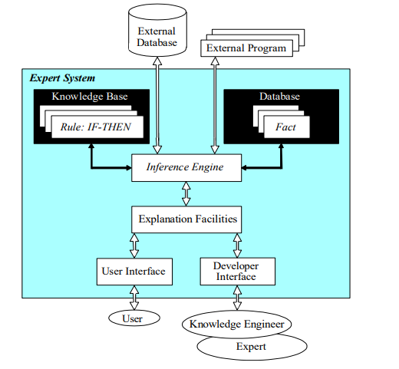
Structural Illustration Of A RBES

Slide 11
3. Structure Of A RBES
In a RBES, the domain knowledge is represented by a set of IF-THEN production rules and data is represented by a set of facts about the current scenario/domain.
When an ES is used, a knowledge engineer or a human expert simply enters rules in the knowledge base.
Each new rule adds some new knowledge and makes the ES smarter.
The inference engine compares each rule stored in the knowledge base with facts contained in the database.
When the IF (condition) part of the rule matches a fact, then rule is fired and its THEN (action) part is executed.

Slide 12
4. The Expert System Shell
Note that in Figure, the components of the expert system that do not contain domain-specific or case-specific information are contained within the expert system shell.
This shell is a general toolkit that can be used to build a number of different expert systems, depending on which knowledge base is added to the shell.
An example of such a shell is CLIPS (C Language Integrated Production System), Other examples in common use include OPS 5 (Official Production System 5), JESS (Java Expert System Shell) etc..

Slide 13
One potential problem with expert systems is the number of comparisons that need to be made between rules and facts in the database. In some cases, where there are hundreds or even thousands of rules, running comparisons against each rule can be impractical. The Rete Algorithm is an efficient method for solving this problem and is used by a number of expert system tools, including OPS5 and Eclipse
5. The Rete Algorithm

Slide 14
6. Knowledge Engineering
Knowledge engineering is a vital part of the development of any expert system.
The knowledge engineer does not need to have expert domain knowledge
But should know how to convert such expertise into the rules that the system uses, preferably in an efficient manner.
Hence, the knowledge engineer’s main task is communicating with the expert, to know how the expert evaluate evidence and what methods he or she uses to derive conclusions.
Having built up a good understanding of the rules the expert uses to draw conclusions, the knowledge engineer must encode these rules in the expert system shell language that is being used for the task.
In some cases, the knowledge engineer will have freedom to choose the most appropriate expert system shell for the task.
In other cases, this decision will have already been made, and the knowledge engineer must work with what he is given.

Slide 15
